Slide 1


Image Formation: A Primer
Understanding the fundamentals of image formation is essential for photographers, engineers, and scientists alike. This primer introduces the core concepts behind how images are created by capturing and manipulating light. From simple pinhole cameras to advanced sensors, each component plays a vital role in the quality and characteristics of the final image.
The following sections will explore models, optics, and technologies that shape how images are formed, focusing on key principles such as light bending, exposure control, and color reproduction. Together, these form the foundation for any imaging system.
by Mugilalone

Slide 2

Pinhole Camera Model: The Foundation
Simplicity of Design
Image Characteristics
Importance in Optics
The pinhole camera is the simplest imaging model, using a tiny aperture to project an inverted image onto a surface without lenses. It demonstrates basic principles of image formation by allowing light from a scene to pass through a small hole.
Produces sharp images with infinite depth of field but requires long exposure times due to low light intake. The image is inverted due to the straight-line propagation of light through the pinhole.
Serves as a fundamental concept for understanding more complex optics and lens systems used in modern cameras and optical devices.

Slide 3
Lenses: Bending Light to Our Will
Function of Lenses
Lens Elements
Lenses focus light rays by refraction, bending them to create clear images. Convex lenses converge light, while concave lenses diverge it, allowing control over image size and focus distance.
Modern lenses consist of multiple glass elements designed to minimize distortions and improve sharpness. Coatings reduce reflections and enhance light transmission for better image quality.

Slide 4

Focus and Depth of Field: Sharpness Control
Focus Explained
Depth of Field
Adjusting the lens position changes where light rays converge, determining which part of the image appears sharp.
Refers to the range of distances within which objects appear acceptably sharp. A shallow depth creates blurred backgrounds, while a deep depth keeps everything in focus.
Creative Use
Photographers manipulate focus and depth of field to guide viewer attention and add artistic effects to images.

Slide 5
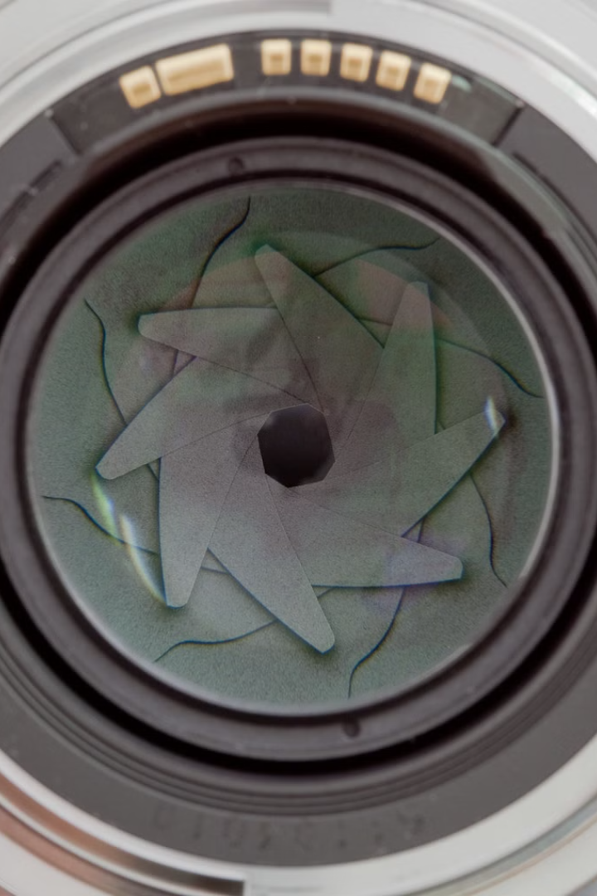



Aperture and Shutter Speed: Exposure Essentials
Aperture
Shutter Speed
Exposure Balance
Controls the size of the lens opening, regulating how much light reaches the sensor. Larger apertures admit more light, allowing faster shutter speeds and shallower depth of field.
Determines how long the sensor is exposed to light. Fast shutter speeds freeze motion, while slow speeds capture motion blur, influencing the exposure and artistic effect.
Balancing aperture and shutter speed is key to achieving proper exposure, ensuring the image is neither too dark nor washed out.

Slide 6






Sensor Technology: Capturing Light
CMOS Sensors
Complementary Metal-Oxide Semiconductor sensors are energy-efficient and dominant in consumer cameras due to their fast readout speeds.
CCD Sensors
Pixel Function
Charge-Coupled Devices offer high image quality and low noise, commonly used in scientific and professional cameras.
Each pixel converts incoming photons into electrical signals, forming the digital representation of the image.

Slide 7

Color Image Formation: RGB and Beyond
1
RGB Color Model
Color images are formed by combining red, green, and blue light intensities. Sensors use a color filter array to capture these components separately.
2
Demosaicing Process
Interpolation algorithms reconstruct full-color images from incomplete color samples at each pixel.
3
Advanced Color Models
Some systems extend beyond RGB, incorporating more color channels for greater fidelity and wider gamut reproduction.

Slide 8




Image Resolution and Pixel Size: Detail Matters
Resolution Defined
The total number of pixels in the image determines its resolution, affecting the amount of detail captured.
Pixel Size Impact
Larger pixels collect more light, improving sensitivity and noise performance, especially in low light conditions.
Trade-offs
High resolution with small pixels may lead to noise, while larger pixels reduce the total resolution but enhance image quality.

Slide 9
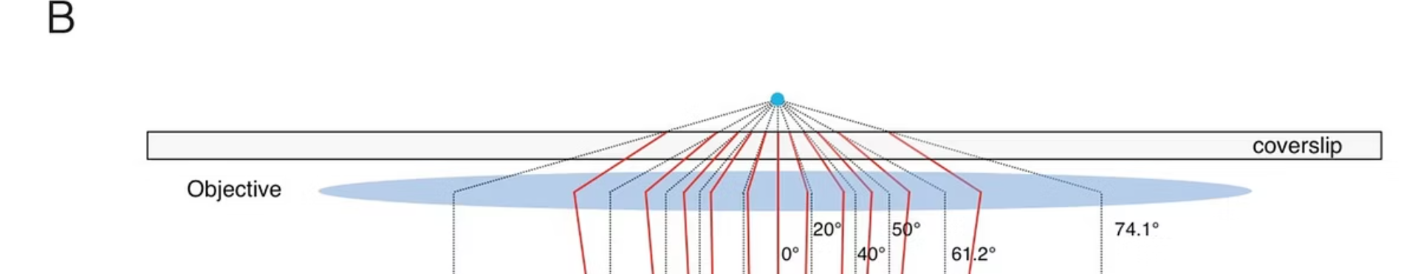
Aberrations: Imperfections in Image Formation
Other Distortions
Spherical Aberration
Includes coma, astigmatism, and field curvature, which warp or blur the image in varying ways.
Chromatic Aberration
Caused by spherical lens surfaces, resulting in blurry images due to inconsistent focus spot sizes.
Occurs when different wavelengths of light focus at different distances, causing color fringing around edges.

Slide 10
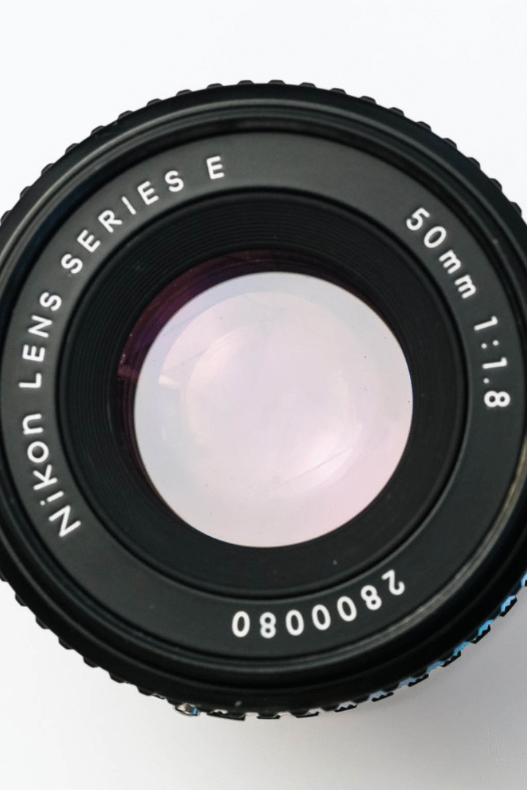
Summary: Key Concepts and Applications
1
Image Formation Journey
2
Control Variables
Focus, aperture, shutter speed, and sensor technology interplay to shape exposure, sharpness, and color fidelity.
From the simple pinhole to advanced sensors and lenses, each step governs image quality and characteristics.
3
Addressing Aberrations
Modern optics and processing techniques actively reduce imperfections to produce stunning, accurate images.
Understanding these principles empowers creators and technicians to optimize their equipment and techniques for diverse imaging needs across photography, microscopy, and computer vision applications.

